Slide 1

An introduction to data analysis using R
Marc A.T. Teunis, Ph.D.
see slides @: http://www.innovativetesting.nl/cprprogramming
Today's to demonstrate the possibilities of using R for your project work;
Questions? I am here to support your data management and analysis

Slide 2
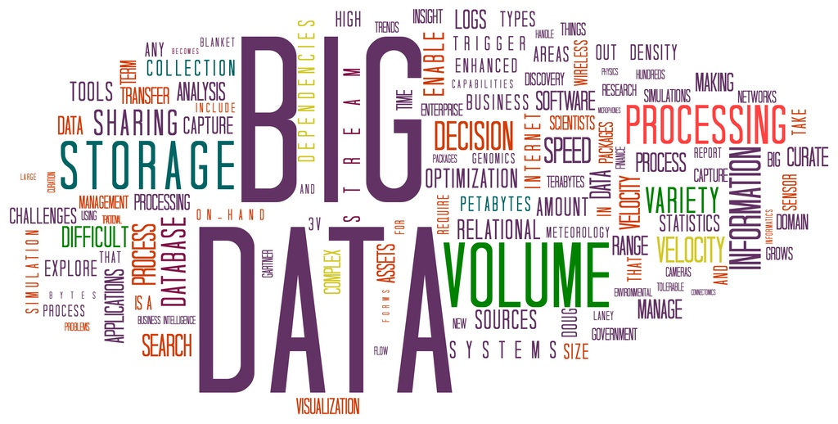
Contents
What is data science?
Datafiles and tidy data
Data management for laboratory experiments
Data analysis workflow
What is R?
Download and install R and RStudio
Getting started with R
Exploratory data analysis in R

Slide 3
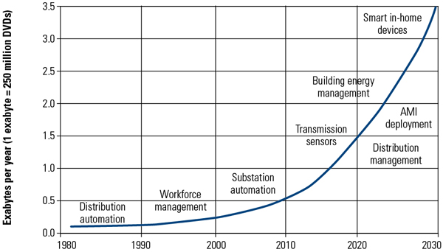
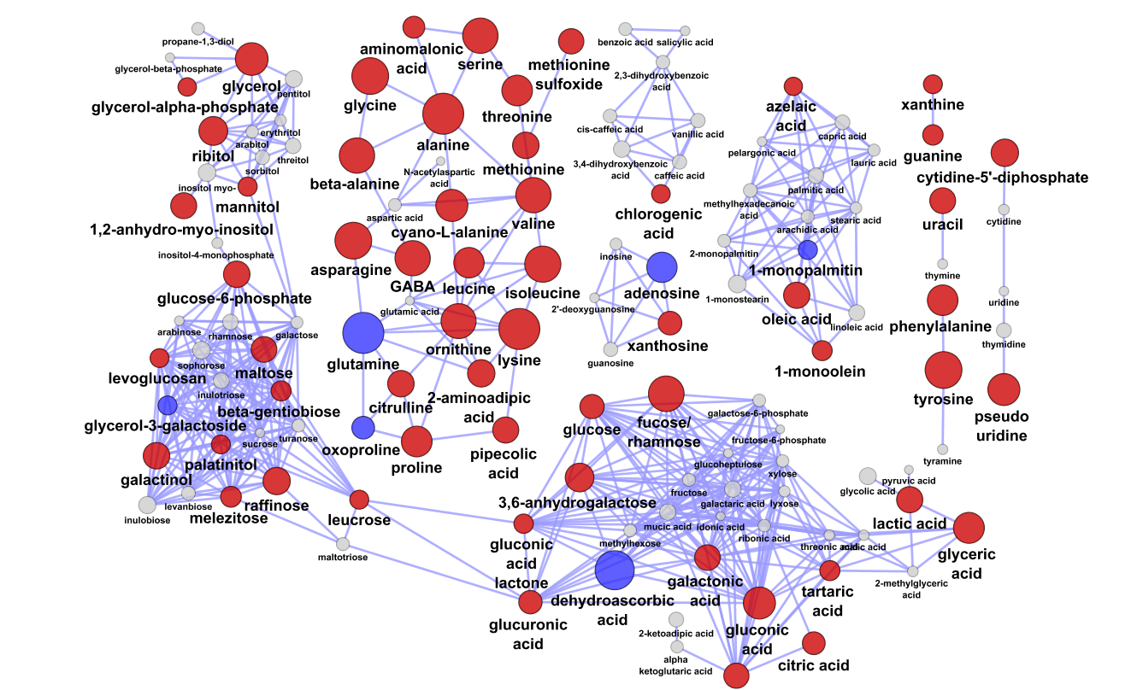
The amount of data is growing
http://www.powermag.com/Assets/Image/Imports/20130101/010113_CS_R&D_Fig5.jpg

Slide 4
Why I use R
R can be a pest to learn in the beginning
Many, many applications (packages/libraries)
Good resources available (web, books, moocs, courses)
It's free!
It's open source!
There is a very large R community of developers (100.000 LinkedIn)
Number possible applications is enormous

Slide 5
Data analysis work flow
Experiment
Raw data
Data frame?
Getting data in R
Clean data
Exploratory data analysis
Check assumptions
Perform statistical analysis
Conclusion
Convert to data frame

Slide 6
Data analysis starts with a (raw) data file
Data file = data frame / matrix / text file / webpage / raw data file
User must be sure to use the correct (raw) data -> README.txt
No graphs etc. included in the MS Excel tab with raw data
Non-proprietary formats: *.csv / *.txt are the best!
Reading MS Excel files is possible
Never edit data (cells) in the original data file!!

Slide 7
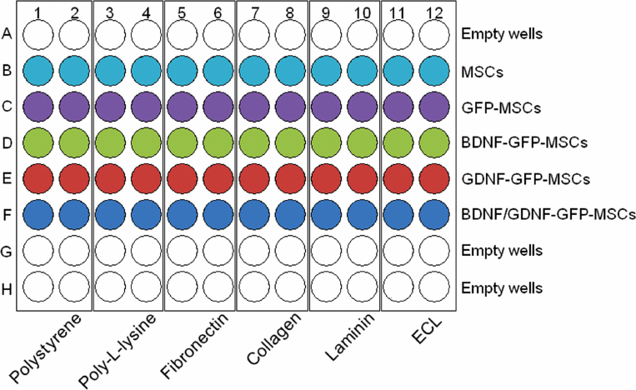
A 96 wells experimental format
0.926 | 0.954 | 0.27 | 0.261 | 0.255 | 0.282 | 0.287 | 0.311 | 0.237 | 0.223 | 0.315 | 0.333
0.721 | 0.695 | 0.26 | 0.257 | 0.254 | 0.253 | 0.281 | 0.299 | 0.063 | 0.052 | 0.262 | 0.26
0.504 | 0.473 | 0.271 | 0.272 | 0.239 | 0.254 | 0.28 | 0.267 | 0.238 | 0.203 | 0.27 | 0.288
0.335 | 0.276 | 0.225 | 0.233 | 0.229 | 0.216 | 0.277 | 0.267 | 0.236 | 0.197 | 0.049 | 0.04
0.205 | 0.181 | 0.247 | 0.24 | 0.232 | 0.209 | 0.251 | 0.28 | 0.226 | 0.189 | 0.277 | 0.29
0.123 | 0.126 | 0.245 | 0.241 | 0.214 | 0.194 | 0.276 | 0.268 | 0.213 | 0.188 | 0.27 | 0.27
0.097 | 0.097 | 0.233 | 0.221 | 0.052 | 0.049 | 0.261 | 0.249 | 0.212 | 0.188 | 0.27 | 0.258
0.042 | 0.047 | 0.254 | 0.245 | 0.25 | 0.214 | 0.257 | 0.261 | 0.221 | 0.202 | 0.296 | 0.332

Slide 8

From experiment to data frame
sample_id | coating | treatment | repeat | optic_density
mte_1_a01 | polysterene | empty_wells | 1 | 0.23
mte_1_a02 | polysterene | empty_wells | 2 | 0.26
mte_1_a03 | poly-l-lysine | empty_wells | 1 | 1.45
…
mte_1_c04 | poly-l-lysine | gfp_msc | 1 | NA
…
mte_1_h12 | ecl | empty_wells | 2 | 2.43
Name the variables according rules on next slide
Start a README.txt
Use one Excel tab to automatically generate a data frame in Excell
Save the data in *.csv or tab delim. (*.txt)

Slide 9
The data frame - "Tidy data"
Tidy data is formatted in a standard way that facilitates exploration and analysis and works seamlessly with other tidy data tools.
Specifically, tidy data satisfies three conditions:
Start at cell A1
First row is header with variable names
Each variable forms a column
2) Each observation forms a row
3) Each type of observational unit forms a table
4) Variables are named according a few strict rules

Slide 10
Things we want to know about the data frame -> README.txt
Name
Date
Type of experiment
Name and Type of variables
Units of variables, possible outcomes
Dimensions of the data frame
Type of data frame
Version?

Slide 11

Missing values?
Do not leave cells blank
Do not delete or change any observation from the data file
Use NA as designator
Using NA ensures possibility to combine data from different experiments (include index variable "unique SampleID")

Slide 12
An introduction to R-programming
Marc A.T. Teunis, PhD
Adapted from
Els Adriaens, PhD, May 2016

Slide 13
What is R?
R is a free open-source software environment for statistical computing and graphics. R (developed by Robert Gentleman and Ross Ihaka, Statistics Department of the University of Auckland in 1995) is a dialect of the S language (developed by AT&T labs).
R is available for Linux, Mac OS X, and Windows platforms.
R is mostly command-line driven, it is a Case-Sensitive, interpreted language.
Basic functions are available by default, other functions are contained in packages that can be attached (currently more than 8000 packages)
Work directly in R workspace or use a basic code editor e.g. RStudio, a free and open source integrated development environment for R that runs on Windows, Mac, Linux, and even over the web using RStudio Server
syntax highlight, create and manage projects, bookmarks: lines and blocks, …

Slide 14
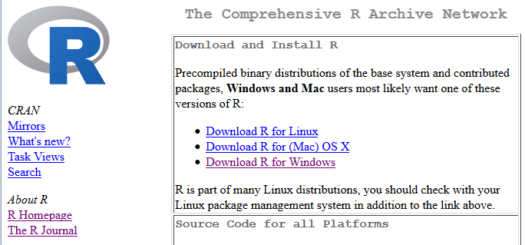
Getting R on your computer
Install R from the Comprehensive R Archive Netwok:
https://cran.r-project.org/
Choose the appropriate version for your OS. Try it now!
Notes:
CRAN: The Comprehensive R Archive Network
The File Transfer Protocol (FTP) is a standard network protocol used to transfer computer files between a client and server on a computer network.
GUI: graphical user interface

Slide 15

RStudio™: An R IDE (Integrated development environment)
RStudio v0.99.1292 Preview
https://www.rstudio.com/products/rstudio/download/preview/ <click image below to download>

Slide 16
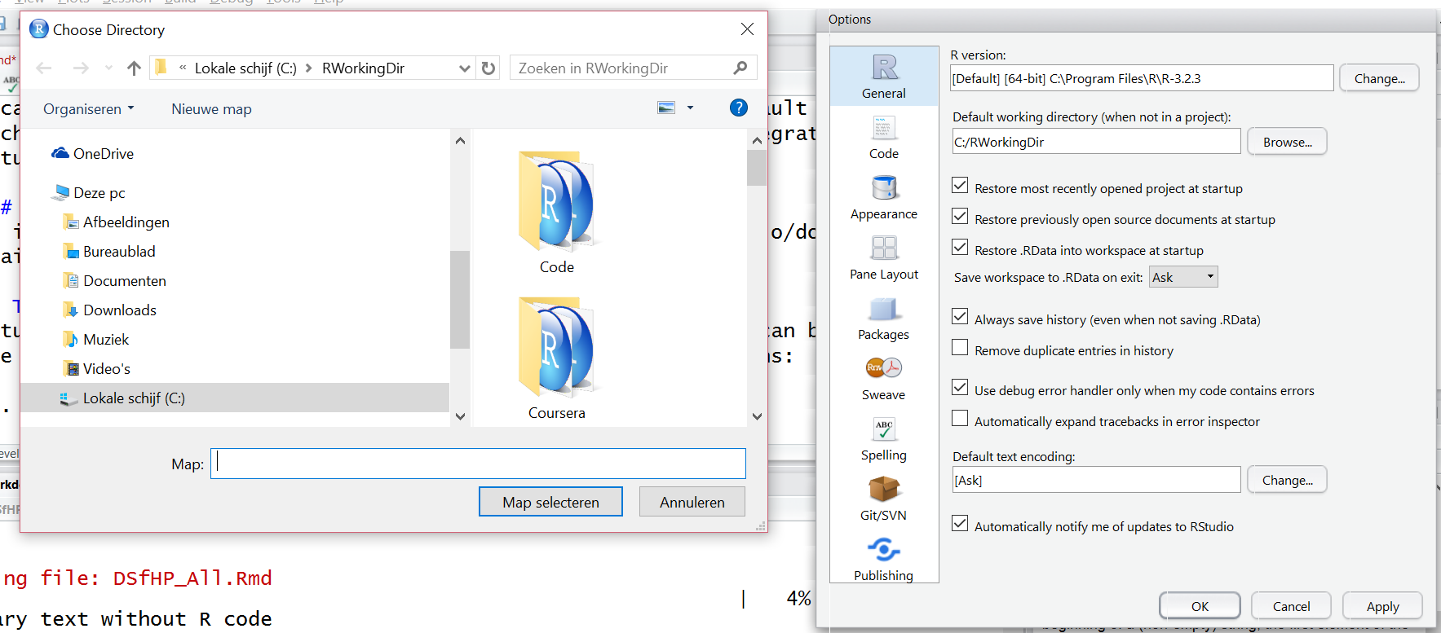
Setting the default working directory

Slide 17
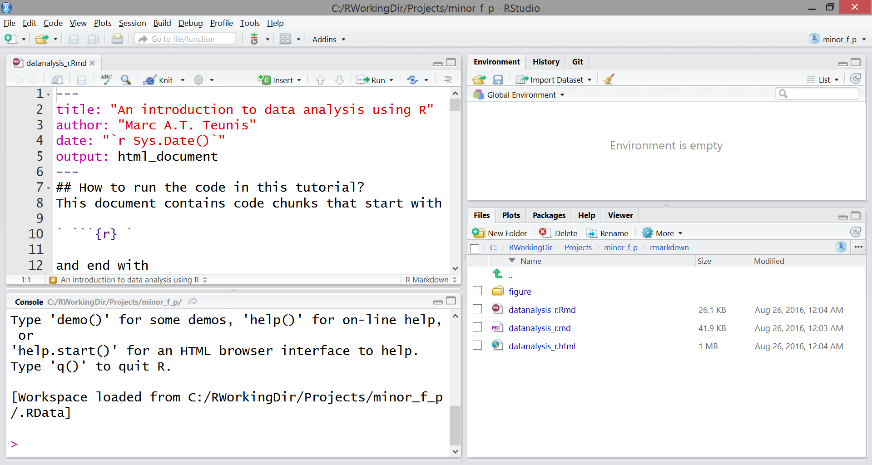
RStudio Software layout
Script editor
Global Environment
Files, Plots,
Help, Packages
Console

Slide 18
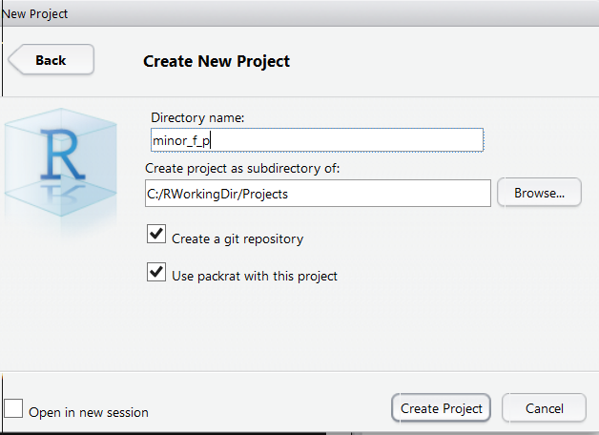
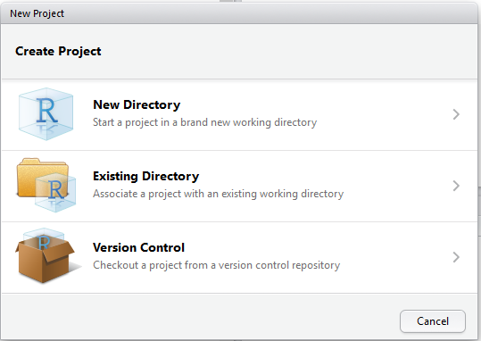
Creating an RStudio Project
"File" → "New Project" → "New Directory"
→ Directory Name "minor_f_p" → check "git repo" and "packrat" → click "Create Project"

Slide 19
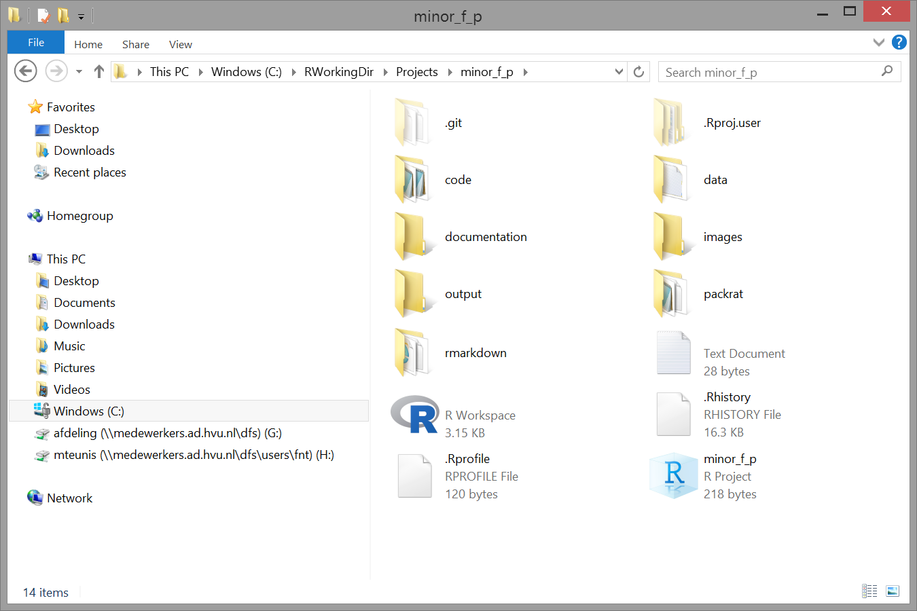
Stand-alone projects
Easy to find your files
Portable
Sharable
Adapt a standard structure and stick to it
README.txt at least in the "data" folder!

Slide 20
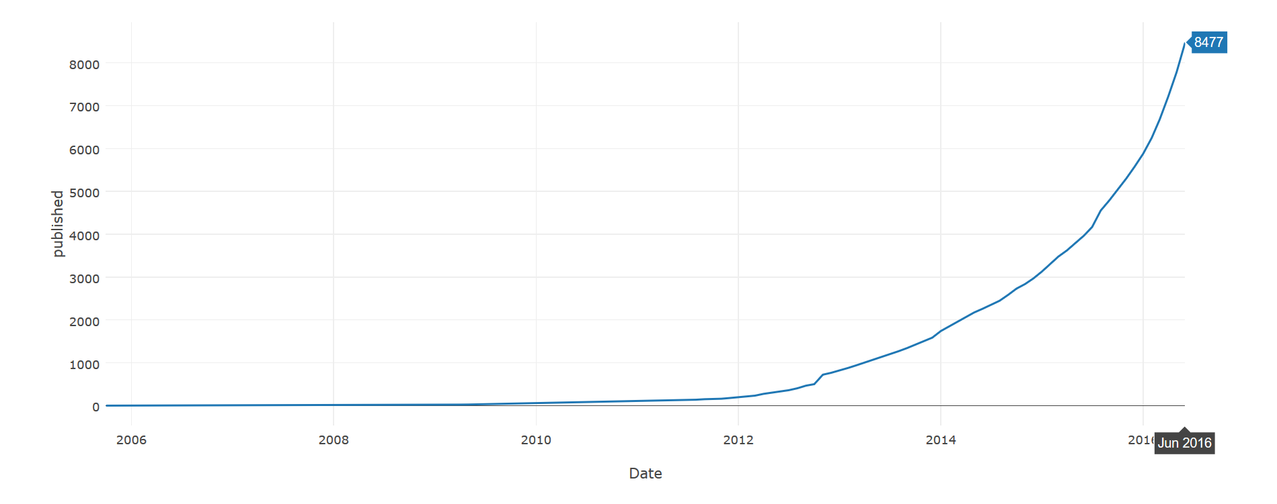
Number of packages – 2006 to 1 june 2016
url <- "https://cran.r-project.org/web/packages/available_packages_by_date.html"
page <- read_html(url)
page %>%
html_node("table") %>%
html_table() %>%
mutate(count = rev(1:nrow(.))) %>%
mutate(Date = as.Date(Date)) %>%
mutate(Month = format(Date, format="%Y-%m")) %>%
group_by(Month) %>%
summarise(published = min(count)) %>%
mutate(Date = as.Date(as.yearmon(Month))) -> pkgs
margins = list(l = 100, r = 100, b = 100, t = 100, pad = 4)
pkgs %>%
plot_ly(x=Date, y=published, name="Published packages") %>%
layout(title = "CRAN packages published ever since.", margin = margins)

Slide 21
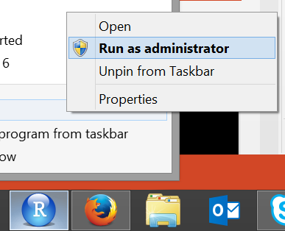
Start interactive part
Interactive session using RStudio
Download the Walkthrough "workshop_r_fp.Rmd"
from: http://www.innovativetesting.nl/sites/default/files/attachment/workshop_r_fp.Rmd
Put the file just created project folder: "minor_f_p"
Run code chunk with keys "Cntrl", "Shift" and "Enter" simultaneously
Run code line with keys: "Cntrl" and "Shift" simultaneously
Select code by dragging left-click mouse, run highlighted code with: "Cntl" and "Shift" simultaneously
Go to RStudio: On Windows run program as "administrator"

